Slide 1
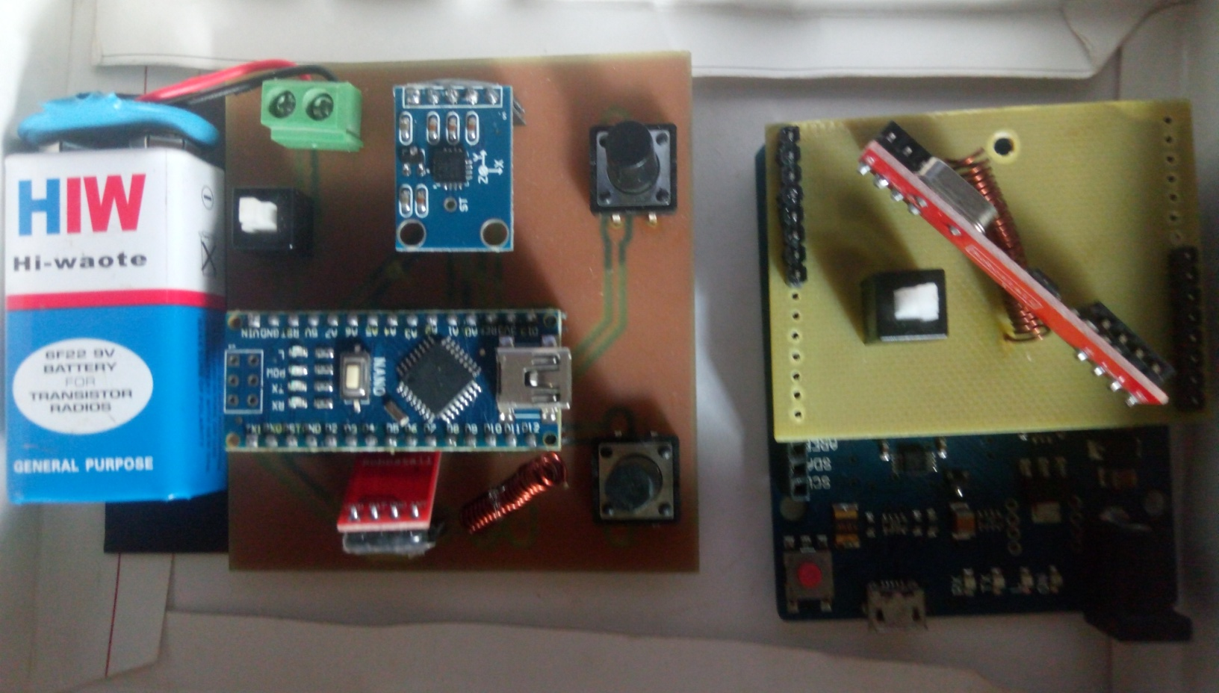
ACCELEROMETER BASED WIRELESS 3D AIR MOUSE

Slide 2
GROUP MEMBERS
Ankith
Bhavana
Karthik
Mallika
Mahender
Nikhil
Sunder
UNDER THE GUIDANCE OF :-
Smt. K. SUNITHA, B.E

Slide 3
OUTLINE OF THE PROJECT:
INTRODUCTION
DESIGN
3D AXIS AND ROLE OF MOUSE IN GAMING
INNOVATION
APPLICATIONS /UTILITY
CONCLUSION

Slide 4
INTRODUCTION:
We have seen different types of Human Interface Devices(HID’S),for example mouse and keyboard.
In older versions of computer mouse, optical sensors were used to detect movement relative to a surface, thus they require smooth surface to connect and function properly.
These mice can work with only two coordinates. With advancements in technology, we are now talking about 3D user interfaces(3DUIs).
The main aim of our project is to change the way of using the traditional mouse and enhance the technology development.

Slide 5
DESIGN
RF transceiver.
To interface MPU 6050 with ArduinoNano.
To control the mouse pointer in computer using Accelerometer.
To rotate 3D objects using Air mouse using ArduinoLenardo.
Push Button for mouse right & left clicks.

Slide 6
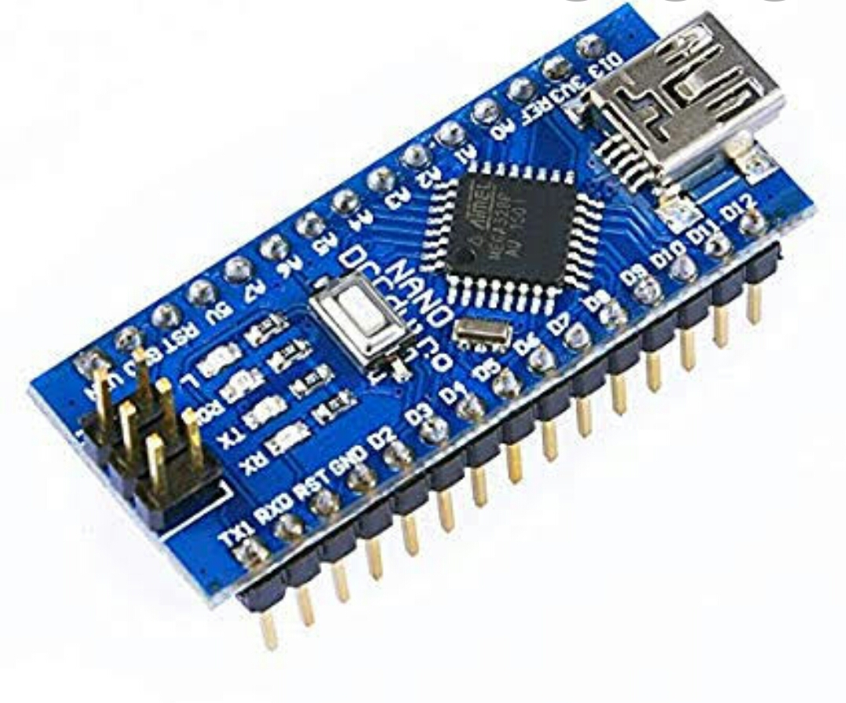
ARDUINO NANO

Slide 7
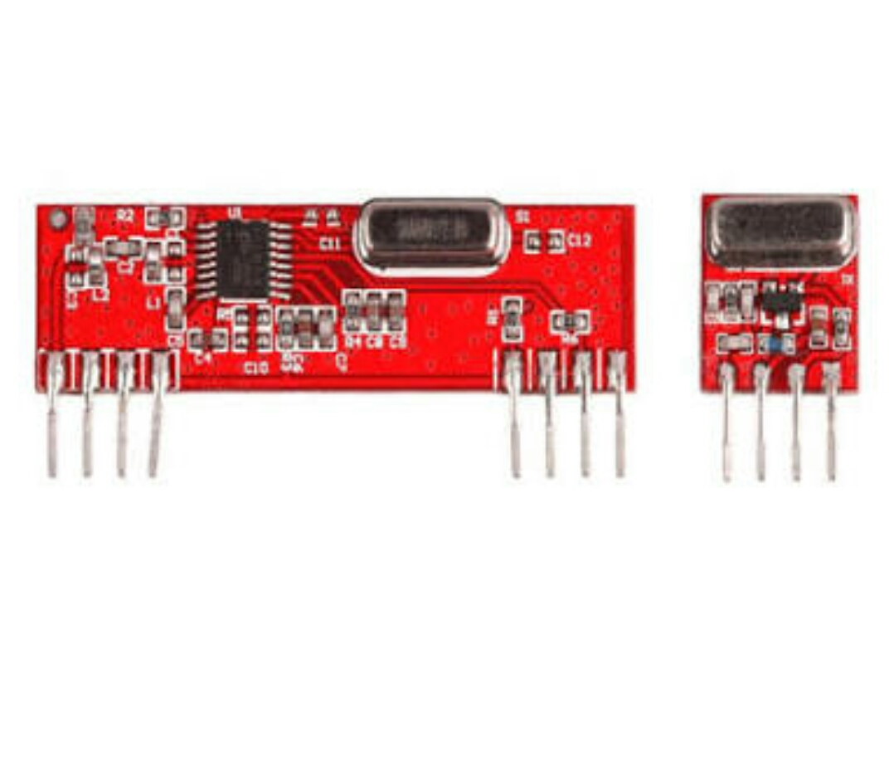
RF-TRANSCEIVER

Slide 8
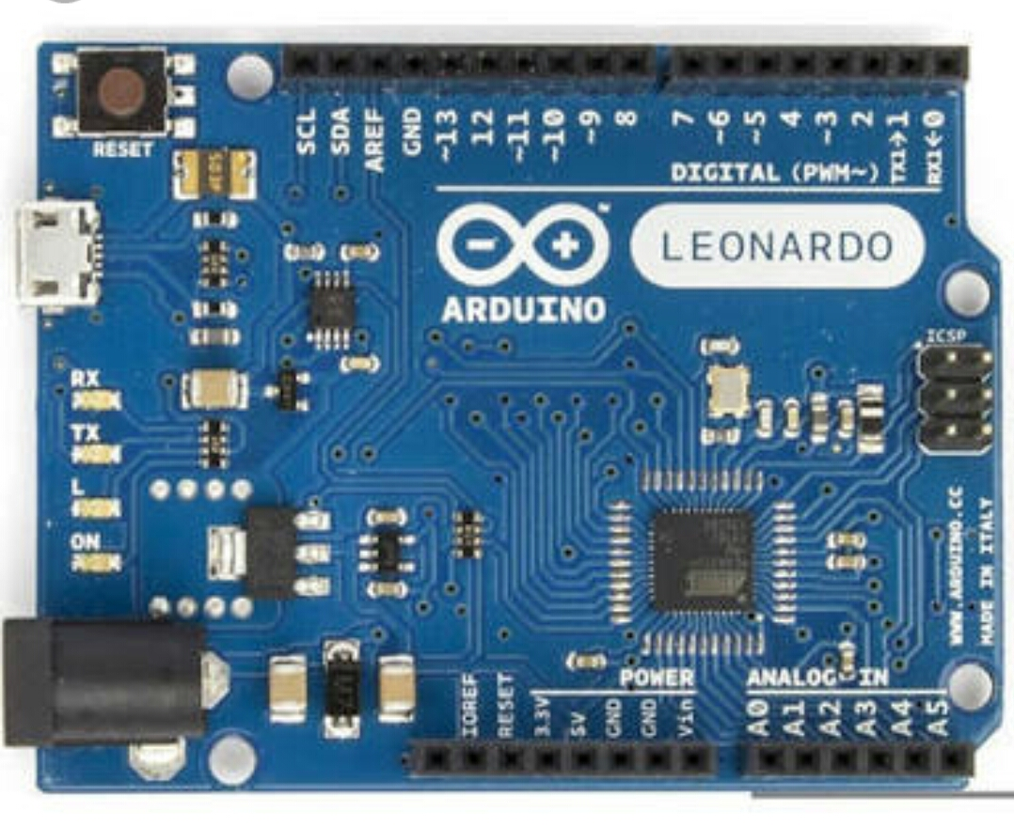
ARDUINO LEONARDO

Slide 9
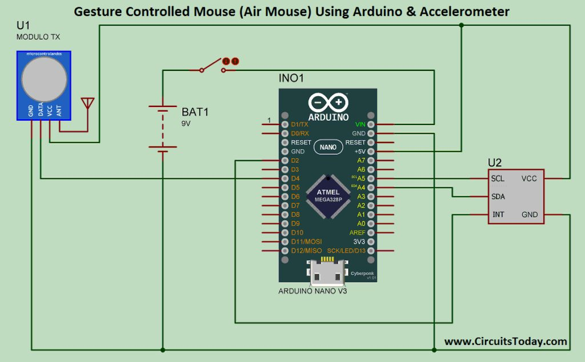
TRANSMITTER BLOCK DIAGRAM

Slide 10
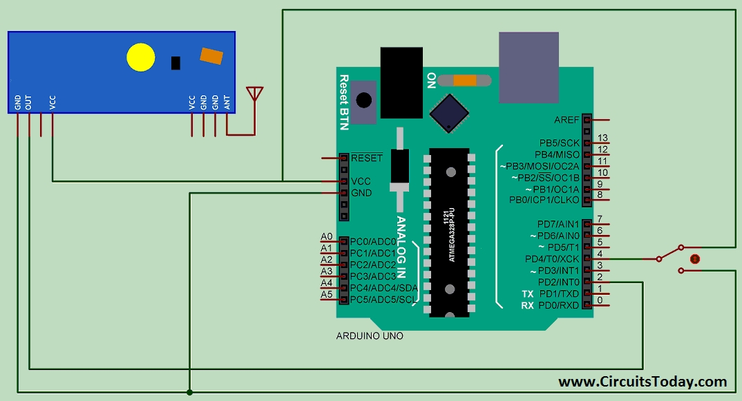
RECEIVER BLOCK DIAGRAM

Slide 11
3D AXIS AND ROLE OF MOUSE IN GAMING
The accelerometer of the mouse, helps to move the mouse in 3 dimensions in air.
With the usage of the sensor the cursor can be pointed a different locations.
The speed of the movement als0 depends on the rise of the angle of holding the mouse.
While in the game, this air mouse can be hovered.

Slide 12
INNOVATION
Presently we are having RF Mouse which is a wireless mouse but controlled in 2D-axis which will work depending on IR sensing
This can be replaced by the 3D mouse.
All the way from traditional PS/2 connector mouse to the latest technology of Air Mouse will be the future.
We can control and create 3D objects with high efficiency and gesture based devices.
This device can be very helpful in making 3D UI(User Interface) based systems. We can use this device in 3D designing as well.

Slide 13
ADVANTAGES OF 3D AIR MOUSE
It doesn’t need any platform and it is portable.
Compare to the normal wireless devices it ranges high.
On basis of accelerometer and motion tracking sensor, it senses the 3d motion in the air.
In the field of gaming the mouse helps us switch between perspectives.

Slide 14
APPLICATIONS/UTILITY
The mouse can be used in air and has respective buttons which also has more range(6m/15ft).
The mouse can sense the movements and transmit it to the receiver in the form of RF(radio frequency)signals.
The mouse is handy.
This can be used for gaming.
This device can be very helpful in making 3d UI based systems.
Ex:- In a class room during the class the lecturer can able to operate device by even monitoring the students instead being at the same position.

Slide 15
CONCLUSION
Main motto of this project is to change the way we use the traditional mouse and introduce 3d interfacing devices.
This mouse can be the first step towards development of 3d UI’s and devices.
This can over come all the problems experienced by the optical and IR mice.

